Slide 1

CS162 Midterm 3 Review
Fall 2024

Slide 2
Disclaimer
This is not an exhaustive review of all topics that are in scope for the midterm.
“You are responsible for the sum total of human knowledge since the beginning of recorded history with particular emphasis on the contents of this course.”
~a certain wise guy at Berkeley

Slide 3
Outline
Scope of midterm: all lectures, homeworks, and projects.
This review session will focus on post midterm 2 material (which will be emphasized on midterm 3).
I/O, Storage Devices, File Systems
Durability, Reliability, Transactions
Distributed Decision Making, Networking
If we have time at the end, we’ll review a bit of queuing theory.

Slide 4
I/O

Slide 5
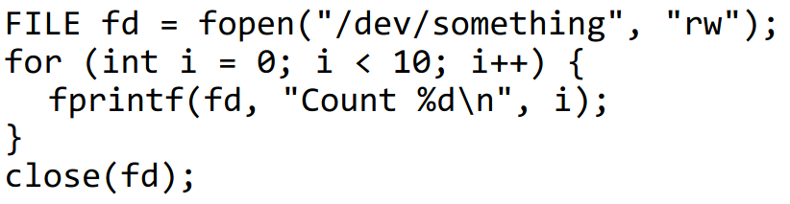
I/O
In Linux, user programs communicate with devices via a standard file-like syscall interface (e.g. open, close, read, write).
For instance, if we wanted to write something to a device, we would do

Slide 6
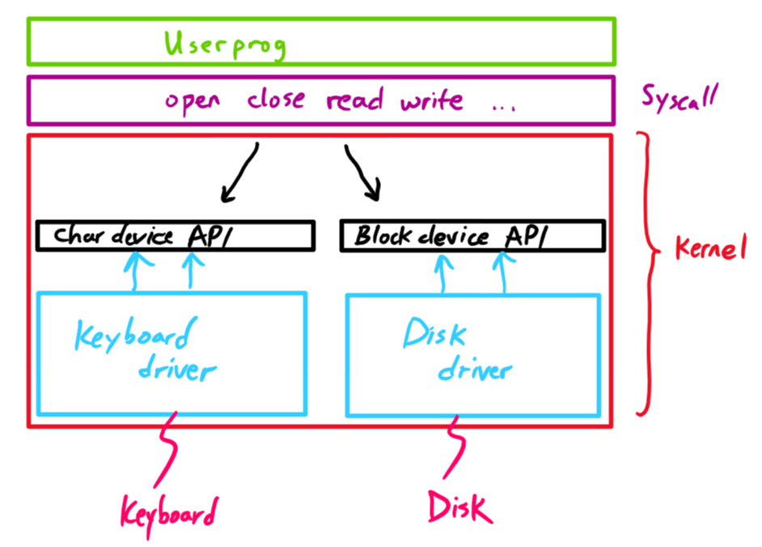
I/O
Kernel: translate these high-level syscalls into device instructions. Depending on the device, it will do so differently.

Slide 7
Device Drivers
How are device drivers implemented? Need a way for CPU to talk to device registers.
CPU is connected to every device via data buses (like the PCI).
Two main ways to communicate: programmed I/O vs. DMA.

Slide 8
Device Drivers
Programmed I/O:
Port-mapped I/O: privileged in/out instructions to communicate with device registers.
Memory-mapped I/O: registers appear in physical address space. Communicate with load/store instructions.
CPU involved in every data transfer.
Often requires polling! (so rather wasteful of CPU cycles)

Slide 9
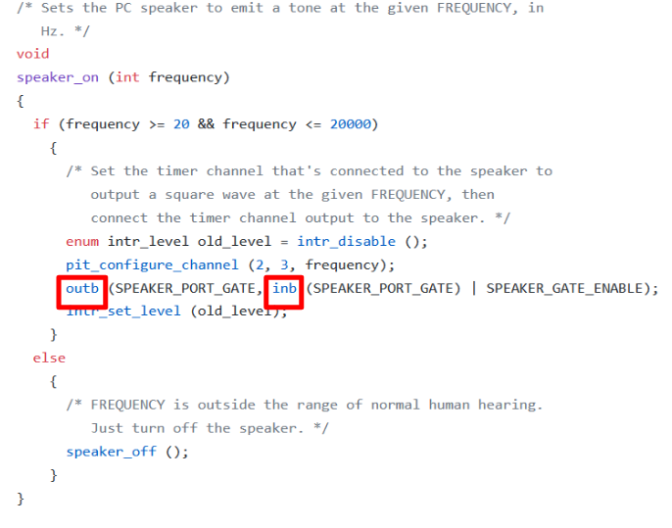
Device Drivers
Example of port-mapped I/O: the speaker driver in Pintos.

Slide 10
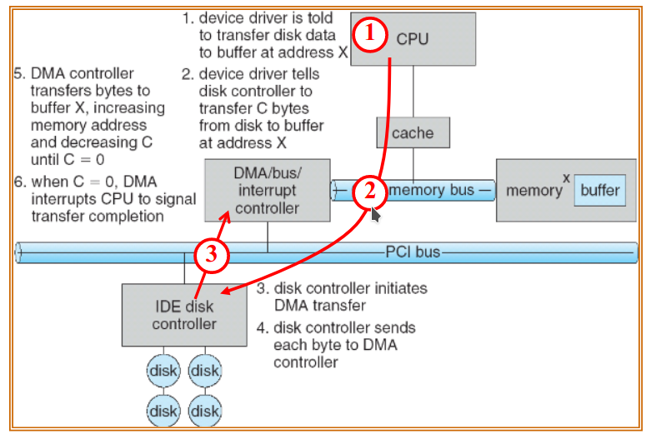
Device Drivers
Direct Memory Access:
CPU gives DMA request to device controller.
Device controller communicates with DMA controller and they work together to transfer data between device and memory.
When finished, DMA controller interrupts CPU.

Slide 11
Device Drivers
Note if a device driver uses DMA, then its code can be split into two parts:
Code that implements the device driver interface (e.g. for a disk driver, the block device interface) and starts the DMA request.
Code that executes once the DMA request finishes and the CPU is interrupted.
The former is called the top half, the latter is called the bottom half.
If we are not using DMA or any interrupt-driven I/O, there would no bottom half.

Slide 12
I/O
Next up: storage devices.
The most important of devices.
Performance is key! (Keep in mind)
Ways to measure performance:
Latency = response time.
Throughput = rate of which tasks are performed (e.g. operations per sec).

Slide 13
Storage Devices

Slide 14
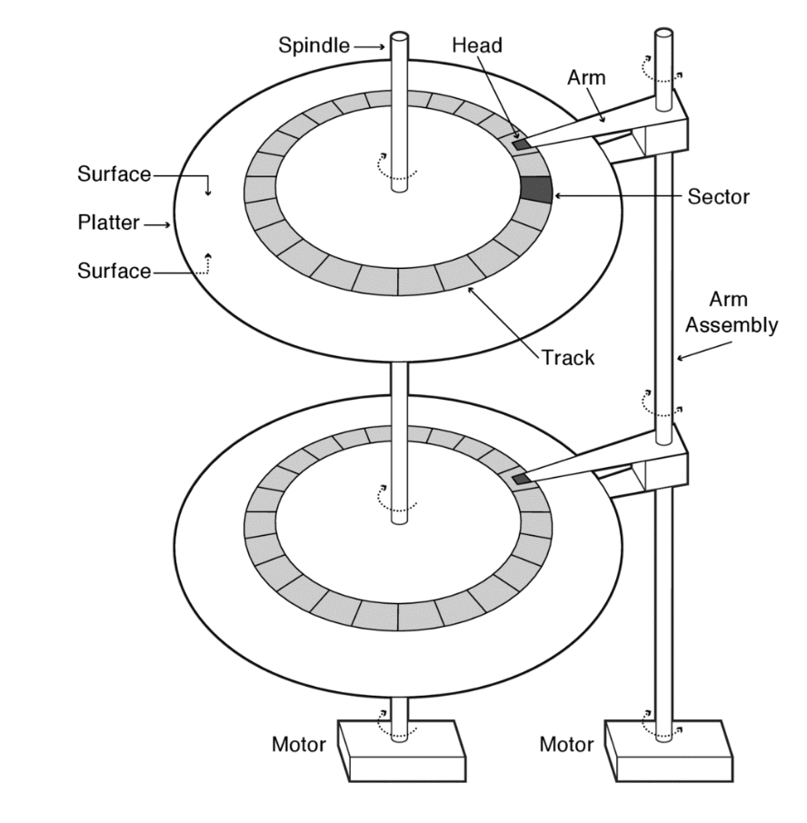
HDDs

Slide 15
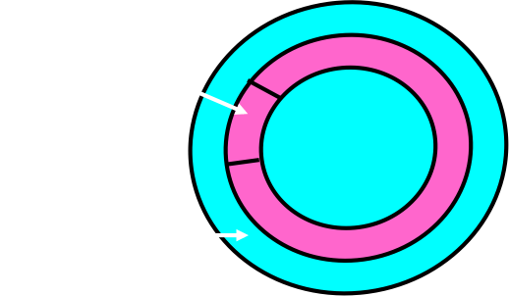

HDDs
Read and write in sectors

Slide 16
HDDs
Latency = Queuing + Controller + Seek + Rotational + Transfer

Slide 17
HDDs
Latency = Queuing + Controller + Seek + Rotational + Transfer
Seek: find desired track
Rotational: wait for desired sector to rotate to you (~half a rotation)
Transfer: read/write data at sector

Slide 18
HDDs
Slow for random reads and writes, faster for sequential
Cheap

Slide 19

SSDs

Slide 20
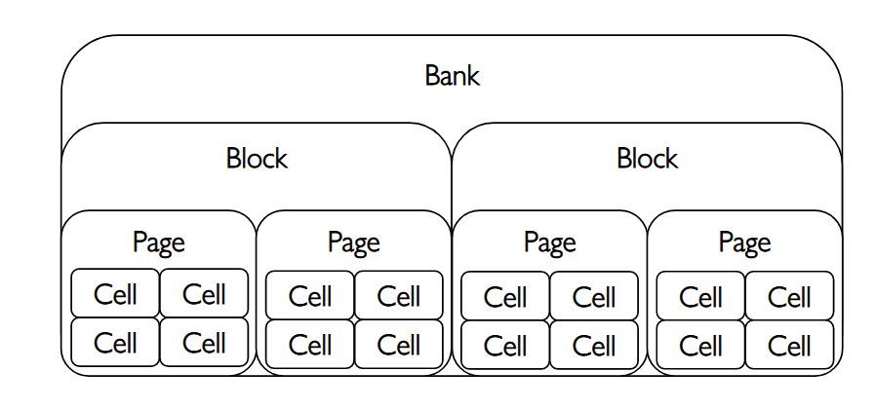
SSDs
Have no moving parts. So no seek and rotational latency!
Latency = Queuing + Controller + Transfer
Read and write in pages (different from “pages” in virtual memory)
Erase in erasure blocks (page << erasure block)

Slide 21
SSDs
Fast for random reads and writes
Erasing slow (and must erase before overwriting)
More expensive than HDDs, erasing wears SSDs out

Slide 22
HDD Questions
We have a hard drive with the following specs:
4096 byte sectors
3,000,000 sectors/track
100 tracks/platter
2 platters*
5400 rpm
5.6ms seek time (avg)
1ms controller+queue time
140MB/s Transfer rate
How big is the drive?
What is the throughput for a 64KB read?
What is the throughput for a 64MB read?
Reminders:
time = queue + controller + seek + rotation + transfer
throughput = amount of memory read / time
*Assume (for simplicity) that data is only stored on ONE SIDE of a platter and all reads are sequential.
Notes:
We normally talk about sectors/inch on a real drive, but assume all tracks have the same number of sectors for simplicity
Assume reads are sequential
3 mins

Slide 23
HDD Questions
1. How big is the drive?
Each track contains 3,000,000 * 4096 B = 12.288 GB
For 100 tracks: 100 * 12.288 GB = 1228.8 GB
2 platters: 2 * 1228.8 GB = 2457.6 GB ~= 2.46 TB

Slide 24
HDD Questions
2. What is the throughput for a 64KB read?
Data: 64KB
Time: queue + controller + seek + rotation + transfer
queue + controller: 1 ms
seek: 5.6 ms
rotation: 1/5400 min = 11.11 ms (worst case) => 5.55 ms (average)
transfer time: 64KB / 140MB/s = 0.457 ms
total time: 1 + 5.6 + 5.55 + 0.457 = 12.60 ms
throughput = 64KB / 0.01260s = 5079 KB/s

Slide 25
HDD Questions
3. What is the throughput for a 64MB read?
Data: 64MB
Time: queue + controller + seek + rotation + transfer
queue + controller: 1 ms
seek: 5.6 ms
rotation: 1/5400 min = 11.11 ms (worst case) => 5.55 ms (average)
transfer time: 64MB / 140MB/s = 457 ms
total time: 1 + 5.6 + 5.55 + 457 = 475.9 ms
throughput = 64MB / 0.4759 s = 134454 KB/s

Slide 26
File Systems

Slide 27
Storage Device Abstraction
To the operating system, a storage device (whether HDD or SSD) is just a indexed array of blocks
For HDDs, a block = a fixed number of sectors
For SSDs, a block = usually the size of an erasure block
In UNIX systems, a block is often 4kb.

Slide 28
Storage Device Abstraction
To the operating system, a storage device (whether HDD or SSD) is just a indexed array of blocks
OS usually can only do two things:
Read to block at any index i
Write to block at any index i
It is the goal of the OS to transform this low level abstraction into a file system.

Slide 29
How do we store files?
We will look at three implementations: FAT, FFS, and NTFS
In all three implementations, each file has a unique file number
To get the contents of a file, all you need is the file number
In fact, file descriptions consist of a file number + offset

Slide 30
Implementation 1: FAT
Developed by Microsoft in the 1970s
File = linked list of blocks
Bookkeeping done by the File Allocation Table (FAT)

Slide 31
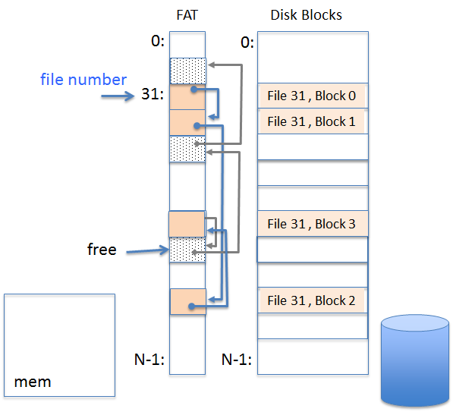
Implementation 1: FAT
FAT is table with entries that correspond one-to-one with blocks and stores linked list information
File number is index of the first block of the file
Follow block list to seek in file
Grow file by appending to list
Unused blocks in FAT are tracked via a free list (also linked)

Slide 32
FAT Assessment
How well does FAT work with:
Sequential Access?
Random Access?
External Fragmentation?
Internal Fragmentation? Small files?
Big files?
Locality for files and metadata?
Notes:
Sequential Access?
Good!
Random Access?
Bad. Traverse linked list.
External Fragmentation?
No external fragmentation.
Internal Fragmentation? Small files?
Too many small files can lead to severe internal fragmentation
Big files?
Usually not problem.
Locality for files and metadata?
Bad, FAT stores the metadata separately from the data, files allocated as linked lists.

Slide 33
FAT Assessment
Sequential Access?
Good!
Random Access?
Bad. Traverse linked list.
External Fragmentation?
No external fragmentation.
Internal Fragmentation? Small files?
Too many small files can lead to severe internal fragmentation
Big files?
Usually not problem.
Locality for files and metadata?
Bad, FAT stores the metadata separately from the data, files allocated as linked lists.
Notes:
Internal fragmentation: wasted space because of allocation in block-sized chunks
External fragmentation: many free spaced holes that are too small to be of any use

Slide 34
FAT Assessment
Simple to implement, but poor performance and little security

Slide 35

Implementation 2: FFS
Developed by Berkeley for BSD!
File number is index into inode array
Each inode corresponds to a file and contains its metadata (but not name)
Beastie, the BSD daemon

Slide 36
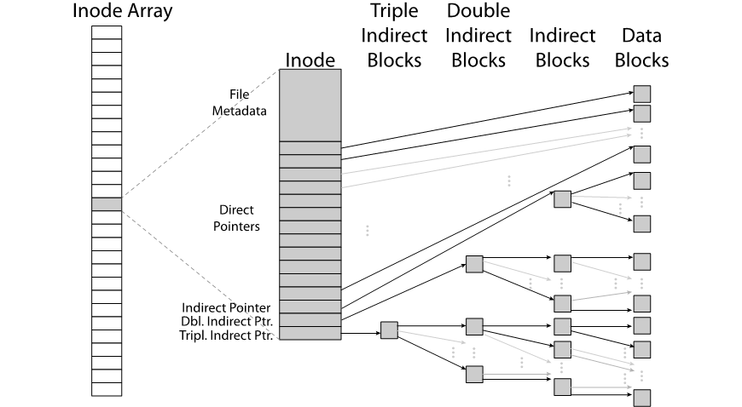
Implementation 2: FFS

Slide 37
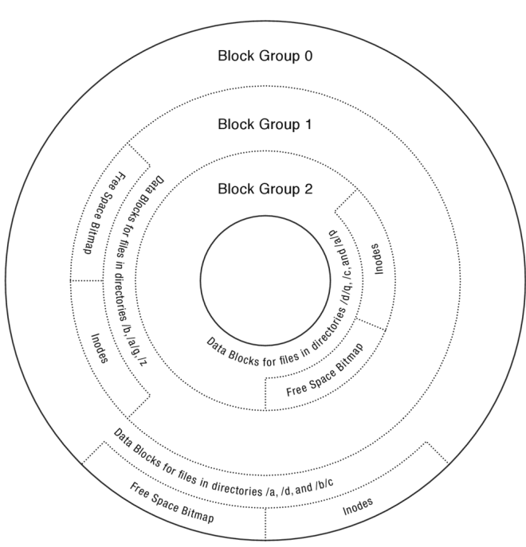
FFS Optimization for HDDs
To optimize FFS for HDDs, we split the disk into block groups:

Slide 38
FFS Optimization for HDDs
To optimize FFS for HDDs, we split the disk into block groups.
Put directory (which is just a file) and its files in common block group

Slide 39
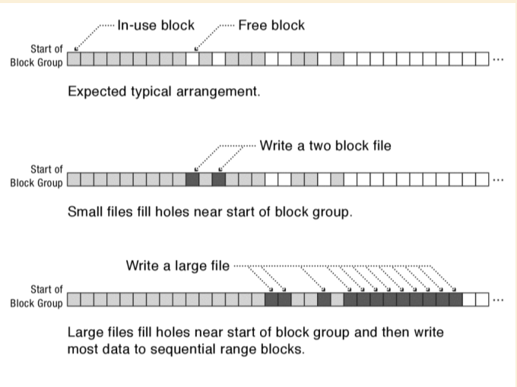
FFS Optimization for HDDs
To allocate new blocks when expanding a file, use a first-free heuristic.
Reason: for large files, will help with locality.
Important: keep 10% or more free

Slide 40
FFS Assessment
How well does FFS work with:
Sequential Access?
Random Access?
External Fragmentation?
Internal Fragmentation? Small files?
Big files?
Locality for files and metadata?
Notes:
Sequential Access?
Good!
Random Access?
Good! Traverse pointers in the inode.
External Fragmentation?
No external fragmentation.
Internal Fragmentation? Small files?
Internal fragmentation for tiny files (an 8 byte file requires both an inode and a data block), but the direct pointers make it generally efficient for small files.
Big files?
Good! Indirect pointers.
Locality for files and metadata?
Yes. The layout (block groups) on disk tries to ensure that.

Slide 41
FFS Assessment
Sequential Access?
Good!
Random Access?
Good! Traverse pointers in the inode.
External Fragmentation?
No external fragmentation.
Internal Fragmentation? Small files?
Internal fragmentation for tiny files (an 8 byte file requires both an inode and a data block), but the direct pointers make it generally efficient for small files.
Big files?
Good! Indirect pointers.
Locality for files and metadata?
Yes. The layout (block groups) on disk tries to ensure that.

Slide 42
FFS Assessment
More complicated than FAT, but has many performance advantages

Slide 43
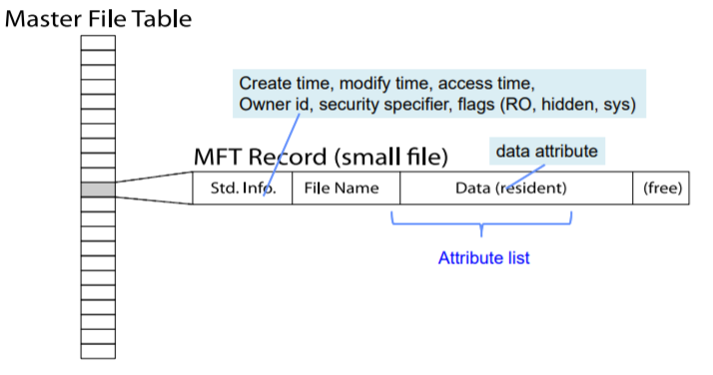
Implementation 3: NTFS
The file system currently used by Windows
Uses a Master File Table instead of inode array
Index into the MFT with file number
Each entry in MFT contains file metadata and data

Slide 44
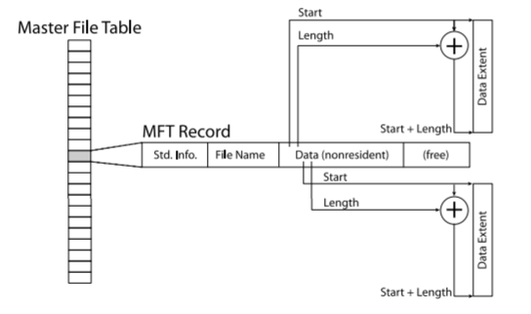
Implementation 3: NTFS
If file is too big to fit in Master File Table, store some data in extents (variable length chunks of data)
Analogous to single pointers in FFS

Slide 45
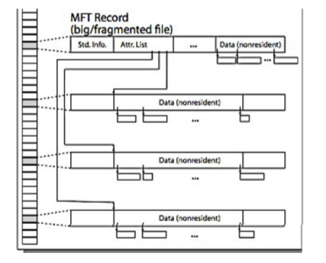
Implementation 3: NTFS
If file is super big, include pointer to lists of extents (analogous to the double pointers in FFS)

Slide 46
NTFS vs FFS
Most fundamental difference is that NTFS uses variable length extents while FFS uses fixed size blocks

Slide 47
What about Directories?
A directory is just a file that contains <name : file number> mappings!
One entry corresponding to each file/subdirectory in the directory
In FAT, file metadata is stored in the directory

Slide 48
More about Directories
The <name: file number> pairs in the directory file are called hard links
Using the link() syscall, a file can have more than 1 hard link. (That is, a file can be part of two different directories).
We only use the term “hard link” if the file system supports multiple hard links to a file.
A file will not be removed until all the hard links to the file are removed (uses a reference count, so FAT does not support hard links!)
A soft link is a special type of entry in the directory file. It is a entry of the form <name: path>. Every time the name is accessed, the OS will lookup the file corresponding to the path, and access that file.
Use the symlink() syscall to create soft links
No reference count
If path doesn’t exist, lookup will fail.

Slide 49
Durability

Slide 50
Durability
How do we prevent loss of data due to disk failure?
Two strategies:
RAID
Erasure codes

Slide 51
RAID
RAID: redundant array of inexpensive disks
Idea: use redundant arrays of inexpensive disks to make filesystems more durable
Many different types of RAID:
We’ll focus on RAID 1 and RAID 5+

Slide 52
RAID 1: Disk Mirroring/Shadowing
recovery
group
Each disk is fully duplicated onto its “shadow”
For high I/O rate, high availability environments
Most expensive solution: 100% capacity overhead
Bandwidth sacrificed on write:
Logical write = two physical writes
Highest bandwidth when disk heads and rotation fully synchronized (hard to do exactly)
Reads may be optimized
Can have two independent reads to same data
Recovery:
Disk failure ⇒ replace disk and copy data to new disk
Hot Spare: idle disk already attached to system to be used for immediate replacement

Slide 53
RAID 5+: High I/O Rate Parity
Data striped across multiple disks
Successive blocks stored on successive (non-parity) disks
Increased bandwidth over single disk
Stripe
Unit
D0
D1
D2
D3
P0
D4
D5
D6
P1
D7
Increasing
Logical
Disk
Addresses
D8
D9
P2
D10
D11
D12
P3
D13
D14
D15
P4
D16
D17
D18
D19
D20
D21
D22
D23
P5
Disk 1
Disk 2
Disk 3
Disk 4
Disk 5

Slide 54
RAID 5+: High I/O Rate Parity
Data striped across multiple disks
Successive blocks stored on successive (non-parity) disks
Increased bandwidth over single disk
Parity block (in green) constructed by XORing data blocks in stripe
P0=D0⊕D1⊕D2⊕D3
Can destroy any one disk and still reconstruct data
Suppose Disk 3 fails, then can reconstruct: D2=D0⊕D1⊕D3⊕P0
Stripe
Unit
D0
D1
D2
D3
P0
D4
D5
D6
P1
D7
Increasing
Logical
Disk
Addresses
D8
D9
P2
D10
D11
D12
P3
D13
D14
D15
P4
D16
D17
D18
D19
D20
D21
D22
D23
P5
Disk 1
Disk 2
Disk 3
Disk 4
Disk 5
Notes:
RAID 6: Can tolerate 2 failures.

Slide 55
General Erasure Codes
Reed-Solomon Error Correcting Codes
A bit mathy: has to do with polynomials of degree m over finite fields
The result: in n disks, can tolerate n-m failures
Incredibly durable!
Notes:
Akash: what?

Slide 56
Reliability

Slide 57
Reliability vs Durability
Durability: being able to recover from a disk failure
Reliability: after recovering from a disk failure, want data in a consistent state
For example: suppose a computer is transfering funds from one bank account to another
If the computer crashes after the withdrawal but before the deposit, we may be able to recover the data, but the data might be wrong

Slide 58
Reliability vs Durability
Durability: being able to recover from a disk failure
Reliability: after recovering from a disk failure, want data in a consistent state
For example: suppose a computer is transfering funds from one bank account to another
If computer crashes after the withdrawal but before the deposit, we may be able to recover the data, but the data might be wrong
Basic idea of solution: want some operations (like withdrawal and deposit) to be atomic
Either both happen, or neither happen

Slide 59

Transactions
A transaction is an atomic sequence of reads and writes that takes the system from one consistent state to another
Transactions have four properties:
Atomicity (see above)
Consistency (Consistency ensures that a transaction can only bring the database from one valid state to another)
Isolation (concurrent execution of transactions is okay)
Durability (once a transaction is committed, it will not be erased in case of disk failure)
Notes:
Akash: isolation?

Slide 60
Transactions
A transaction is an atomic sequence of reads and writes that takes the system from one consistent state to another
Want to update the disk by transactions, not by individual reads and writes.
Two ways to do this:
Journaling filesystem
Log structured file system
Both implementations use a log (a buffer on the disk)

Slide 61
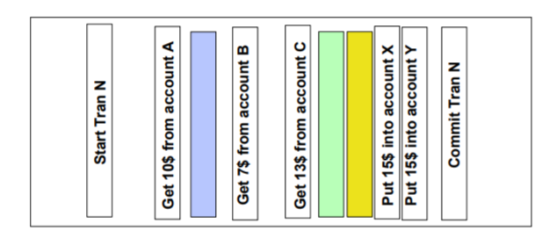
Logs
Assuming read/write are atomic operations, can implement transactions by writing to a log:

Slide 62
Journaling Filesystem
Instead of writing to the desired blocks on disk directly, write to log
Once a whole transaction is written to log, the disk will apply the changes in the transaction to itself
Once change is applied, remove transaction from log

Slide 63
Journaling Filesystem
Instead of writing to the desired blocks on disk directly, write to log
Once a whole transaction is written to log, the disk will apply the changes in the transaction to itself
Once change is applied, remove transaction from log
If system crashes when writing to log, will get an incomplete transaction that will not be applied
If system crashes when applying changes disk, we can simply re-apply the transaction (by looking at the log) after recovering

Slide 64
Journaling Filesystem
The ext3 filesystem (which used to be the default filesystem for Linux) is basically FFS + logs

Slide 65
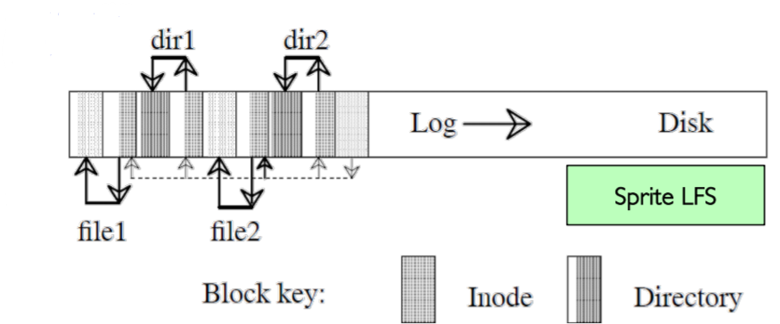
Log Structured File System
Data stays in log form (basically, the file system is the log itself)
To create two files: dir1/file1, dir2/file2

Slide 66
Break!

Slide 67
Logging Tradeoffs
Is it faster to write 100 random 512 byte sectors in a normal file system, or in a log-structured file system ?
Is it faster to write 100 1MB sequential sectors in a normal file system, or in a log-structured file system?

Slide 68
Logging Tradeoffs
Is it faster to write 100 random 512 byte sectors in a normal file system, or in a log-structured file system ?
The log-structured file system might perform better because writes are written sequentially in the log. During the write-back phase, better scheduling could lead to faster write-back than 100 random writes.
Is it faster to write 100 1MB sequential sectors in a normal file system, or in a log-structured file system ?
The normal file system might perform better because the costs of logging dominate. In the non-log-structured file system the writes are largely sequential.

Slide 69
Demand Paging
When you run out of physical memory for applications: store memory pages in disk to make space, pull them out of disk when necessary.
Ideally, store pages on disk that will not be used for a long time ⇒ keep most used pages in memory
Think of physical memory as a “cache” for disk.

Slide 70
Terminology
Working set of a process: Pages that are used by a process within a given time interval.
Resident set of a process: Set of pages that are actually loaded into physical memory.
Ideally, the working set is a subset of the resident set. Not usually the case, but we can try to maximize the overlap.

Slide 71
Page Replacement Policies
Much like caches, need to evict unused pages.
Ideally, MIN:
replace the page that will be referenced furthest in the future or not at all
LRU? Good idea, but implementing LRU is inefficient in hardware.
Approximating LRU is good enough: Clock
Key idea: Replace an old page, not the oldest page.

Slide 72
Clock Algorithm
Each cache entry (or PTE) keeps track of extra bit called use bit (a.k.a. clock bit, reference bit)
Use bit 1 means young; use bit 0 means old
Upon hit, set the entry’s use bit to 1
Upon miss
Clock hand sweeps over entries until finding one to evict:
If entry has use bit 1, clear it (set it to 0)
If entry has use bit 0, evict this entry
Sets use bit of new entry to 1

Slide 73
Clock Algorithm Example
We have a 4-entry empty cache/PT and access A B C B D A E B D A

Slide 74
Clock Algorithm Example
We have a 4-entry empty cache/PT and access A B C B D A E B D A
A
1

Slide 75
Clock Algorithm Example
We have a 4-entry empty cache/PT and access A B C B D A E B D A
A
1
B
1

Slide 76
Clock Algorithm Example
We have a 4-entry empty cache/PT and access A B C B D A E B D A
C
1
A
1
B
1

Slide 77
Clock Algorithm Example
We have a 4-entry empty cache/PT and access A B C B D A E B D A
C
1
A
1
B
1

Slide 78
Clock Algorithm Example
We have a 4-entry empty cache/PT and access A B C B D A E B D A
D
1
C
1
A
1
B
1

Slide 79
Clock Algorithm Example
We have a 4-entry empty cache/PT and access A B C B D A E B D A
D
1
C
1
A
1
B
1

Slide 80
Clock Algorithm Example
We have a 4-entry empty cache/PT and access A B C B D A E B D A
D
1
C
1
A
1
B
1

Slide 81
Clock Algorithm Example
We have a 4-entry empty cache/PT and access A B C B D A E B D A
D
1
C
1
A
0
B
1

Slide 82
Clock Algorithm Example
We have a 4-entry empty cache/PT and access A B C B D A E B D A
D
1
C
1
A
0
B
0

Slide 83
Clock Algorithm Example
We have a 4-entry empty cache/PT and access A B C B D A E B D A
D
1
C
0
A
0
B
0

Slide 84
Clock Algorithm Example
We have a 4-entry empty cache/PT and access A B C B D A E B D A
D
0
C
0
A
0
B
0

Slide 85
Clock Algorithm Example
We have a 4-entry empty cache/PT and access A B C B D A E B D A
D
0
C
0
E
1
B
0

Slide 86
Clock Algorithm Example
We have a 4-entry empty cache/PT and access A B C B D A E B D A
D
0
C
0
E
1
B
1

Slide 87
Clock Algorithm Example
We have a 4-entry empty cache/PT and access A B C B D A E B D A
D
1
C
0
E
1
B
1

Slide 88
Clock Algorithm Example
We have a 4-entry empty cache/PT and access A B C B D A E B D A
D
1
C
0
E
1
B
1

Slide 89
Clock Algorithm Example
We have a 4-entry empty cache/PT and access A B C B D A E B D A
D
1
C
0
E
1
B
0

Slide 90
Clock Algorithm Example
We have a 4-entry empty cache/PT and access A B C B D A E B D A
D
1
A
1
E
1
B
0

Slide 91
Networks and Distributed Systems

Slide 92
Distributed Consensus Making

Slide 93
Problem
Previously, we talked about transactions and logging on a single machine
Consistency!
What if we want to coordinate multiple computers, i.e.
Ensure consistent transactions in a sharded database
Why we care:
For instance, for durability, we could duplicate a lot of machines, each with a journaling/log-structured file system.
Then keeping the machines consistent with each other is an important problem

Slide 94
Solution
Two phase commit:
One machine is designated as the coordinator, everyone else is a participant
The coordinator requests that all participants vote to commit or rollback the transaction
Participants record vote in its own log, then tell coordinator
If anyone votes to abort, coordinator writes "Abort" in its log and tells everyone to abort; each records "Abort" in log
After all participants respond that they are prepared, then the coordinator writes "Commit" to its log
Then asks all nodes to commit; they respond with ACK

Slide 95
2PC Walkthrough (Successful COMMIT)
B
Txn 1
INSERT INTO…
C
A
D

Slide 96
2PC Walkthrough
B
VOTE-REQ - Txn1
Txn 1
INSERT INTO…
C
A
VOTE-REQ - Txn1
VOTE-REQ - Txn1
D

Slide 97
2PC Walkthrough
B
VOTE-REQ - Txn1
Txn 1
INSERT INTO…
VOTE-REQ
Coordinator sends VOTE-REQ message
Participants generate VOTE-COMMIT or VOTE-ABORT, flush to disk
Respond yes/no
What happens if participant recovers and sees no VOTE-REQ record?
C
A
VOTE-REQ - Txn1
VOTE-REQ - Txn1
D
Notes:
Since it has not sent out any vote messages, it aborts the transaction locally. No messages need to be sent out (the participant has no knowledge of the coordinator ID).

Slide 98
2PC Walkthrough
B
VOTE-COMMIT - Txn1
Txn 1
INSERT INTO…
C
A
VOTE-COMMIT - Txn1
VOTE-COMMIT - Txn1
D

Slide 99
2PC Walkthrough
B
VOTE-COMMIT - Txn1
Txn 1
INSERT INTO…
VOTE-COMMIT
Coordinator generates GLOBAL-COMMIT record if all nodes respond with Yes
Ensures all nodes can execute transaction and can commit
Else, we log GLOBAL-ABORT record
What happens if participant wakes up and sees VOTE-COMMIT record?
C
A
VOTE-COMMIT - Txn1
COMMIT
VOTE-COMMIT - Txn1
D
Notes:
ask the coordinator whether a commit happened ("Did the coordinator log a commit?"). The coordinator can be determined from the coordinator ID stored in the prepare log record. Implementation specific- but can also ask if we

Slide 100
2PC Walkthrough
B
GLOBAL-COMMIT - Txn1
Txn 1
INSERT INTO…
C
A
GLOBAL-COMMIT - Txn1
COMMIT
GLOBAL-COMMIT - Txn1
D
Notes:
Rerun Phase 2
Send ACK

Slide 101
2PC Walkthrough
B
GLOBAL-COMMIT
Coordinator broadcasts result of vote COMMIT/ABORT
Participants log result, and respond with ACK
What happens if coordinator/participant wakes up and sees GLOBAL-COMMIT record?
GLOBAL-COMMIT - Txn1
Txn 1
INSERT INTO…
C
A
GLOBAL-COMMIT - Txn1
COMMIT
GLOBAL-COMMIT - Txn1
D
Notes:
Rerun Phase 2
Send ACK

Slide 102
2PC Walkthrough
B
ACK - Txn1
Txn 1
INSERT INTO…
C
A
ACK - Txn1
COMMIT
ACK - Txn1
D

Slide 103
2PC State Machines
Coordinator
Worker
Init
Recv: Vote-Request
Send: Vote-Abort
Init
Recv: Start
Send: Vote-Request
Recv: Vote-Request
Send: Vote-Commit
Wait
Ready
Recv: >= 1 Vote-Abort
Send: Global-Abort
Recv: All Vote-Commit
Send: Global-Commit
Recv: Global-Abort
Send: Abort action
Recv: Global-Commit
Send: Commit action
Abort
Commit
Abort
Commit
If a timeout occurs while coordinator is in wait state, then Global-Abort is sent to all workers.
If worker times out in ready, then that means the coordinator crashed. This is solved in one of two ways:
Can block and continue to ask coordinator for Global-*.
(Optimization) Can ask other workers what message they got, if any, and decide on what to do.

Slide 104
2PC Problem
A Two-Phase Commitment: You maintain a distributed key-value store with one coordinator server (C1) and 2 worker servers (W1 and W2).
Consider the following series of events for adding a K-V pair (Obi, 1) under a perfect execution of two-phase commit protocol.
Notes:
obi1 get it get it
hehe

Slide 105
1 | C1: Log (BEGIN)
2 | C1: Log (PREPARE PUT "Obi”, “1")
3 | C1 -> W1: VOTE-REQ (PUT "Obi”, “1”)
4 | W1: Log (PREPARE PUT "Obi”, “1")
5 | W1 -> C1: Send (VOTE-COMMIT)
6 | C1 -> W2: VOTE-REQ (PUT "Obi”, “1”)
7 | W2: Log (PREPARE PUT "Obi”, “1")
8 | W2 -> C1: Send (VOTE-COMMIT)
9 | C1: Log (GLOBAL-COMMIT)
10 | C1 -> W1: Send (GLOBAL-COMMIT)
11 | W1: Log (COMMIT)
12 | W1: PUT "Obi”, “1"
13 | W1 -> C1: Send (ACK)
14 | C1 -> W2: Send (GLOBAL-COMMIT)
15 | W2: Log (COMMIT)
16 | W2: PUT "Obi”, “1"
17 | W2 -> C1: Send (ACK)
18 | C1: PUT "Obi, “1"
19 | C1: Log (END)
Server C1 crashes right after step 10. What actions will it take upon recovery? Assuming no other crashes, will the key-value pair be added to any of the servers and why?
Give a timestep right after which a single server crash could block the entire system (no progress is made) until it is brought back online.
Notes:
C1 finds GLOBAL-COMMIT in its log, so it resends the GLOBAL-COMMITs. The KV pair will be added.

Slide 106
1 | C1: Log (BEGIN)
2 | C1: Log (PREPARE PUT "Obi”, “1")
3 | C1 -> W1: VOTE-REQ (PUT "Obi”, “1”)
4 | W1: Log (PREPARE PUT "Obi”, “1")
5 | W1 -> C1: Send (VOTE-COMMIT)
6 | C1 -> W2: VOTE-REQ (PUT "Obi”, “1”)
7 | W2: Log (PREPARE PUT "Obi”, “1")
8 | W2 -> C1: Send (VOTE-COMMIT)
9 | C1: Log (GLOBAL-COMMIT)
10 | C1 -> W1: Send (GLOBAL-COMMIT)
11 | W1: Log (COMMIT)
12 | W1: PUT "Obi”, “1"
13 | W1 -> C1: Send (ACK)
14 | C1 -> W2: Send (GLOBAL-COMMIT)
15 | W2: Log (COMMIT)
16 | W2: PUT "Obi”, “1"
17 | W2 -> C1: Send (ACK)
18 | C1: PUT "Obi, “1"
19 | C1: Log (END)
Server C1 crashes right after step 10. What actions will it take upon recovery? Assuming no other crashes, will the key-value pair be added to any of the servers and why?
C1 finds GLOBAL-COMMIT in its log, so it resends the GLOBAL-COMMITs. The KV pair will be added.

Slide 107
1 | C1: Log (BEGIN)
2 | C1: Log (PREPARE PUT "Obi”, “1")
3 | C1 -> W1: VOTE-REQ (PUT "Obi”, “1”)
4 | W1: Log (PREPARE PUT "Obi”, “1")
5 | W1 -> C1: Send (VOTE-COMMIT)
6 | C1 -> W2: VOTE-REQ (PUT "Obi”, “1”)
7 | W2: Log (PREPARE PUT "Obi”, “1")
8 | W2 -> C1: Send (VOTE-COMMIT)
9 | C1: Log (GLOBAL-COMMIT)
10 | C1 -> W1: Send (GLOBAL-COMMIT)
11 | W1: Log (COMMIT)
12 | W1: PUT "Obi”, “1"
13 | W1 -> C1: Send (ACK)
14 | C1 -> W2: Send (GLOBAL-COMMIT)
15 | W2: Log (COMMIT)
16 | W2: PUT "Obi”, “1"
17 | W2 -> C1: Send (ACK)
18 | C1: PUT "Obi, “1"
19 | C1: Log (END)
Give a timestep right after which a single server crash could block the entire system (no progress is made) until it is brought back online.
C1 crashes after step 8 or 9.

Slide 108
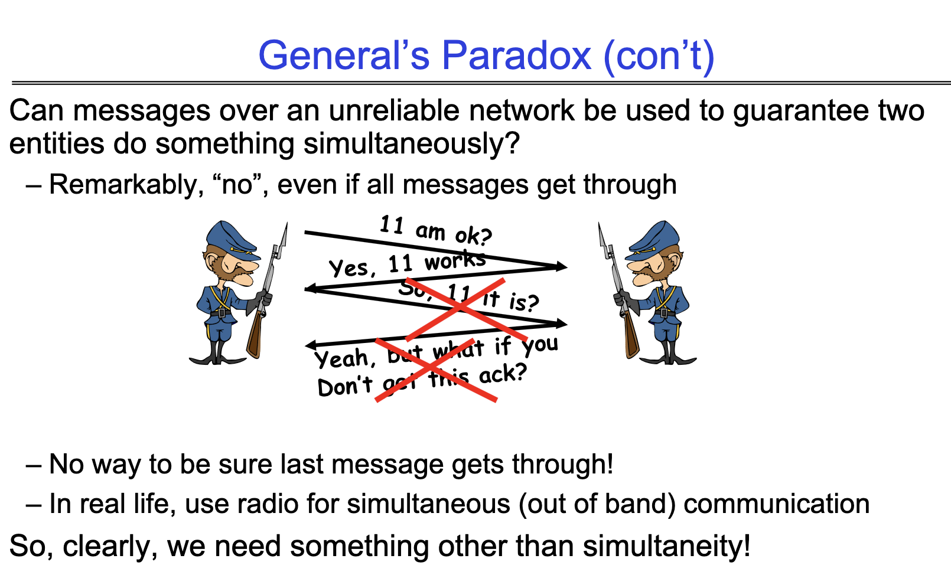
Problems and Paradoxes
Active recall: Explain the General’s Paradox and why it doesn’t apply to 2 phase commit.

Slide 109
Problems and Paradoxes
General’s paradox:
Messages over an unreliable network cannot guarantee entities to do something simultaneously
Does not apply to 2PC because the machines are not trying to agree to do something simultaneously in 2PC.

Slide 110
Networks

Slide 111
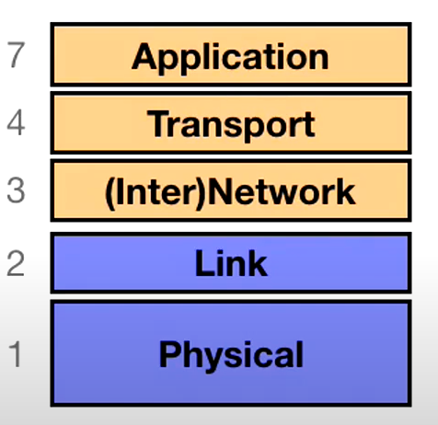
The Internet
Internet: used to move data from one location to another
To do so, need protocols (agreements on how to communicate)
The protocol for communicating on the internet has a layered structure:
Each layer provides more services upon the previous layer

Slide 112
The Internet
This is all very abstract, and in this class we only really care about the network and transport layers, so in this review session, we’re going to adopt a simplistic view of the internet:
The basic unit of communication on the internet is a network packet
A packet consists of a chunk of data, some metadata, a source IP address, and a destination IP address (and is limited size)
When computer A wants to communicate with computer B, it sends a bunch of network packets with computer B’s IP as destination. The packets then travel through a bunch of routers, eventually arriving at computer B.
Routers try to send the packet to a router closer to the destination IP.

Slide 113
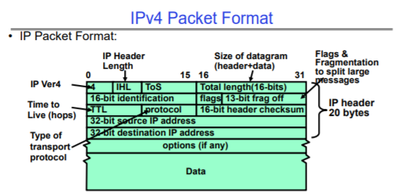
The Internet

Slide 114
The Internet
Problems:
Packets do not support ports.
Packets are unreliable (may get dropped when jumping through routers, or get corrupted, or may be received in a different order than sent)
Solution is to build the transport layer on top of the packets:
UDP: “best-effort delivery”
TCP: reliable in-order delivery (but higher overhead than UDP)

Slide 115
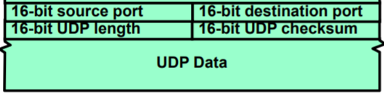
UDP
In UDP, the data portion of a packet is formatted like:
Notice we can now use ports.
However, this still doesn’t solve the problem of dropped/out-of-order packets

Slide 116
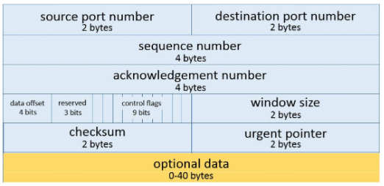
TCP
In TCP, the data portion of a packet is formatted like:
The additional fields allow us to do many things.

Slide 117
TCP
Sequence number: tells you the original order the packets were sent (allows receiver to reconstruct this order)
Starting at a random number (determined by TCP handshake), index every byte of message
Sequence number is the index of the first data byte in the packet
ACK number: after receiving some packets, receiver sends a packet back with ACK number being the next sequence number receiver is expecting
Sender then uses the ACK number to determine which packets have been dropped, and resends these packets

Slide 118
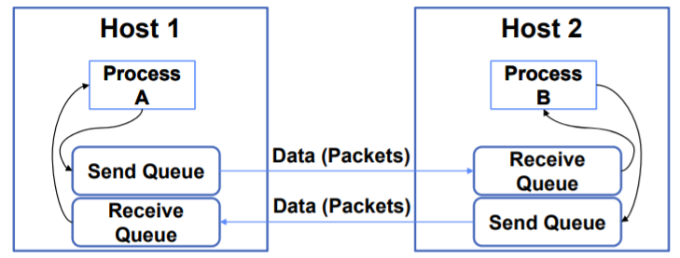
TCP
What’s window size?
Let’s say two computers are communicating with TCP:
A host’s window size for a TCP connection is how much remaining space it has in its receive queue
TCP sender ensures it doesn’t overwhelm the receiver by sending more bytes than the receiver's window size (unless resending old packets)

Slide 119
TCP
How do you determine how much data to send before waiting for ACKs?
Goal: want to avoid too much congestion.
Solution:
Start small, increasing sending size slowly
If timeout, cut sending size by half
“Additive Increase, Multiplicative Decrease”

Slide 120
UDP and TCP
What is provided by TCP that is NOT provided by UDP?
When might a TCP sender send a packet that has more bytes than the receiver’s advertised window?
Name one important feature of TCP/UDP that is NOT provided by plain IP.
Notes:
What is provided by TCP that is NOT provided by UDP? Reliable inorder delivery and congestion avoidance.
When might a TCP sender send a packet that has more bytes than the receiver’s advertised window? When re-sending packets that were lost. The advertised window is for new data.
Name one important feature of TCP/UDP that is NOT provided by plain IP. Multiplexing of different processes via port number.

Slide 121
UDP and TCP (soln.)
What is provided by TCP that is NOT provided by UDP? Reliable inorder delivery and congestion avoidance.
When might a TCP sender send a packet that has more bytes than the receiver’s advertised window? When re-sending packets that were lost. The advertised window is for new data.
Name one important feature of TCP/UDP that is NOT provided by plain IP. Multiplexing of different processes via port number.

Slide 122
Midterm Practice
Do take a look at the TCP window question on FA2020 M3 (if you have time).

Slide 123
Distributed File Systems
Notes:
*These topics are less important compared to the rest

Slide 124
Distributed File Systems
In distributed file systems, part of the file system is stored on a remote server.
For instance, /home/oksi/162/ on your laptop actually refers to /users/oski on campus file server

Slide 125
Distributed File Systems
How do they work?
So far, we’ve gone over:
File systems
Distributed systems + networks
We’re going to try to put all these together to build distributed file systems.
Need one more concept: RPCs

Slide 126
RPC
Basic idea: want to call a procedure on another machine (i.e. server)
RPC (remote procedure calls) allow you to do this, and bundles all the technicalities (like transforming between big and little-endian, pointers, networking) behind a simple interface
So for instance, if the client calls
remoteFileSys->Read("lalala");
It gets translated automatically into call on server:
fileSys->Read("lalala");
To do all this, RPCs have to marshal data into some canonical form

Slide 127
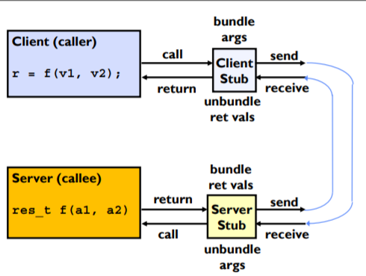
RPC
Basic idea: want to call a procedure on another machine (i.e. server)
RPC (remote procedure calls) allow you to do this, and bundles all the technicalities (like transforming between big and little-endian, pointers, networking) behind a simple interface

Slide 128
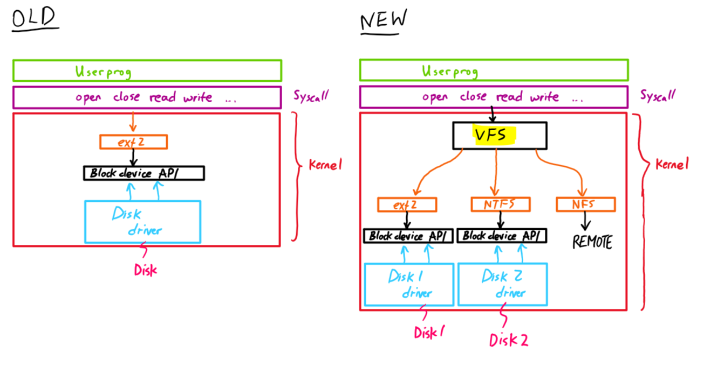
Building a Distributed FS
Step 1: distinguish between remote files and local files.
Solution: add a layer of abstraction with the virtual file system (VFS).
Notes:
Note: in addition to remote files, VFS also allows us to support multiple file systems (e.g. NTFS, ext2) on different disks at the same time.

Slide 129
Building a Distributed FS
Step 2: handle remote files.
We will be using NFS, the network file system.
Basic idea: NFS translates read and write calls from VFS into RPCs (which are then executed on the remote file system).
The RPCs are stateless (and idempotent)
e.g. reads include information for entire operation, such as ReadAt(inumber, position), not Read(openfile)
no open() and close() RPCs
Cache in local computer, poll server periodically to check for changes (server can be bottleneck).
Write-through caching: modified data is committed to server’s disk before results are returned to the client.
If multiple clients write to the same file, results are arbitrary.

Slide 130
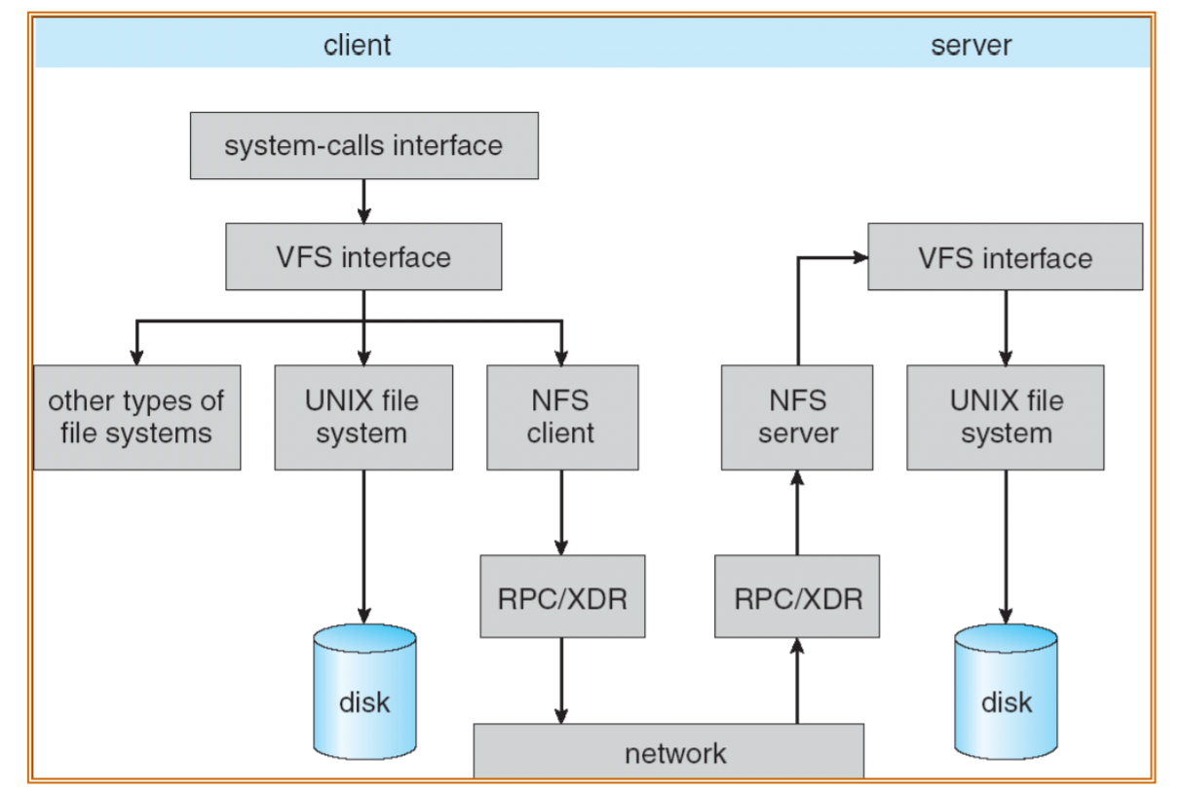
NFS

Slide 131
Queueing Theory

Slide 132
Terminology
Model arrivals to a queue probabilistically
Mean (m): Average value the distribution takes on.
Variance: (σ²): Measure of average spread of values.
C: σ²/m²: Squared coefficient of variance:
Important values: C = 0: constant distribution (fully deterministic)
C = 1: Memoryless

Slide 133
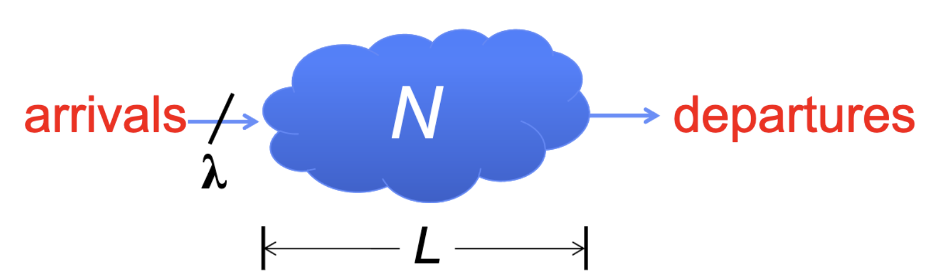
Little’s Law
In any stable system
Average arrival rate = Average departure rate
The average number of tasks in the system (N) is equal to the λ arrival time times the response time (L)
Arrival time = throughput = λ
N (jobs) = λ (jobs/s) x L (s)
Regardless of structure, bursts of requests, variation in service
Instantaneous variations, but it washes out in the average

Slide 134
A Little Queuing Theory: Some Results
Assumptions:
System in equilibrium; No limit to the queue
Time between successive arrivals is random and memoryless
Parameters that describe our system:
λ: mean number of arriving customers/second
T_{ser}: mean time to service a customer (“m1”)
C: squared coefficient of variance = σ²/m1²
μ: service rate = 1/T_{ser}
u: server utilization (0≤u≤1): u = λ/μ = λ × T_{ser}
Parameters we wish to compute:
T_{q}: Time spent in queue
L_{q}: Length of queue = λ × T_{q} (by Little’s law)
Queue
Server
Arrival Rate
λ
Service Rate
μ=1/T_{ser}
Results (M: Poisson arrival process, 1 server):
Memoryless service time distribution (C = 1): Called an M/M/1 queue
T_{q} = T_{ser} x u/(1 – u)
General service time distribution (no restrictions): Called an M/G/1 queue
T_{q} = T_{ser} x ½(1+C) x u/(1 – u))

Slide 135
Modeling Queues - M/M/1, M/G/1, M/M/m
first letter refers to distribution of arrivals: “Memoryless” exponential distribution - rate at any time is constant
second letter refers to service distribution: M: memoryless, G: general distribution w/ own mean, variance
last letter - number of “servers”

Slide 136
Queuing Qn
McDowell’s is a famous family restaurant in Queens, New York, known for its fine dining and rapid
service. Let us say that a customer enters the drive-through every 5 seconds. From the moment the
customer enters the drive-through, he will be able to leave the drive-through, with his food, in 60 seconds. How many people are waiting in the drive-through at any given time?

Slide 137
Queuing Qn
McDowell’s is a famous family restaurant in Queens, New York, known for its fine dining and rapid
service. Let us say that a customer enters the drive-through every 5 seconds. From the moment the
customer enters the drive-through, he will be able to leave the drive-through, with his food, in 60 seconds. How many people are waiting in the drive-through at any given time?
Use Little's Law.
Length of queue = Arrival rate (or Throughput) * Average Time Spent in Queue
= (1 person / 5 seconds) * 60 seconds # of people in the drive through
= 12 people in drive-thru on average.
This logically makes sense, because when a 13th person enters the queue, the first person would have been waiting for 60 seconds and departs. Hence, the length is on average 12 people (and it is always 12 people if each person arrives exactly 5 seconds apart and spends exactly 60 seconds in the queue)

Slide 138
Queuing Qn [cntd]
Utilization is defined as arrival rate/service rate. However, this means that utilization can easily exceed 1 if T_{ser} (or lambda) is large enough. Why do we limit our analysis of queues to utilization in the range [0, 1]?
u = utilization = λ / μ where λ is the arrival rate, μ (service rate) = 1 / T_{ser}

Slide 139
Queuing Qn [cntd]
Utilization is defined as arrival rate/service rate. However, this means that utilization can easily exceed 1 if T_{ser} (or lambda) is large enough. Why do we limit our analysis of queues to utilization in the range [0, 1]?
If the arrival rate exceeds the service rate, then on average, with each customer, the length of the queue will grow without bound. Thus we are dealing with an "infinite" queue, and it is pointless to examine the system. This is why utilization is restricted to values of [0, 1].
Remember the system has to be stable !
Queueing theory applies to a system where the long term, steady behavior approaches "average arrival rate = average departure rate"

Slide 140
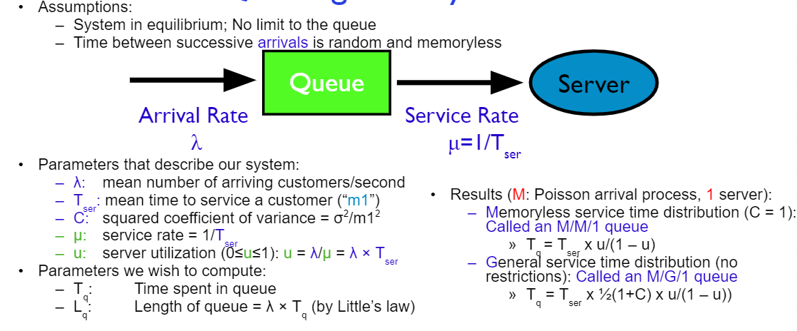
Queueing Qn [cntd]
Consider the scenario where one customer walks into McDowell’s per minute. On average, it takes 30 seconds to serve the customer at the front of the line. Calculate the average length of the line assuming that the system is memoryless.

Slide 141
Queuing Qn [cntd]
Consider the scenario where one customer walks into McDowell’s per minute. On average, it takes 30 seconds to serve the customer at the front of the line. Calculate the average length of the line assuming that the system is memoryless.
T_{Queue} = T_{Served} * (u/ 1 - u)
u = arrival rate * T_{Served}
u = 1 customer / minute * 0.5 minutes = 0.5
T_{Queue} = 0.5 minutes * 0.5 / 0.5 = 0.5
Length of Queue = Arrival Rate (or Throughput) * Average time spent in queue (or response time)
Length of Queue = 1 person / minute * 0.5 minutes in queue = 0.5 persons.
This means on average, there are 0.5 persons in the queue. Keep in mind that this is an *average* (which is why the number is a fraction). It could be that for the most part, there are no people in the queue, but occasionally, it takes the cashier far longer than 30 seconds to serve the customer at the front of the line, creating a temporary backlog.

Slide 142
Good Luck!!

